Slide 1
Imposter Syndrome
Introduction to communications – C464

Slide 2
What is imposter syndrome?
Feeling out of place, like you don’t belong
Self talk, telling yourself you aren’t qualified for a role
That generalized feeling that you don’t belong

Slide 3
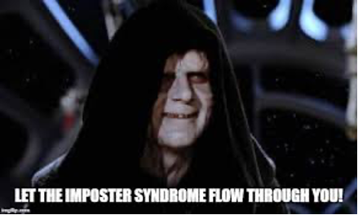
Promotion after 14 years…Hello imposter
imposter syndrome" Memes & GIFs. (n.d.). Retrieved from https://imgflip.com/tag/imposter+syndrome

